Slide 1
Confusion Matrix 이해하기
캐코송이2기
정형데이터조
임 준

Slide 2
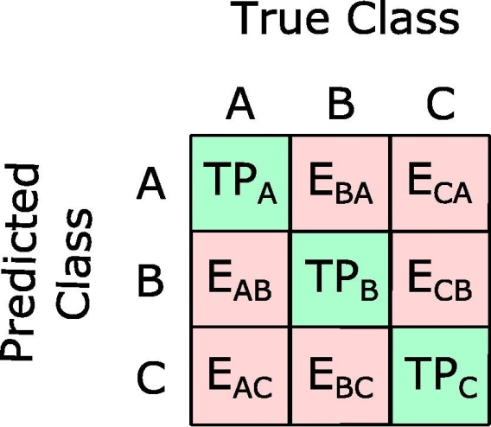
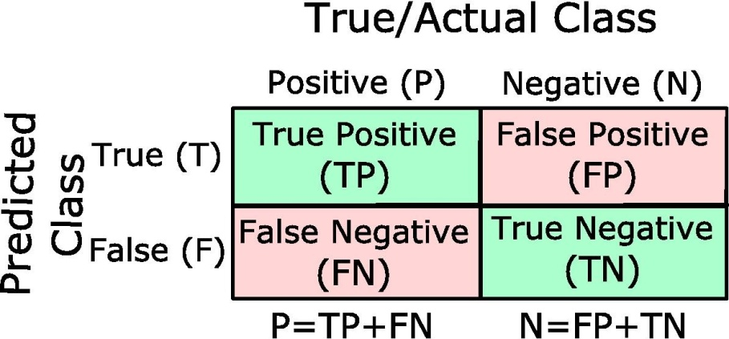
Confusion Matrix
Page. 1
머신러닝 분류모델의 성능척도로 사용
표본의 분류(예측)클래스와 실제클래스를 Matrix 형태로 표현
Binary classification
Multi-class classification

Slide 3
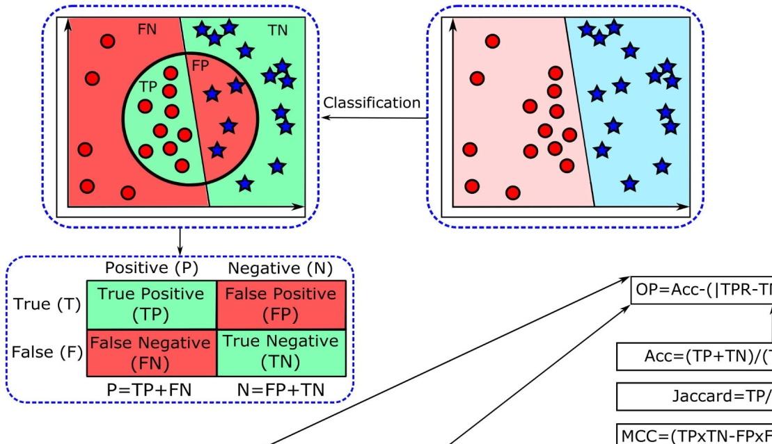
Confusion Matrix
Page. 2

Slide 4
Confusion Matrix
Page. 3
TP: If the sample is Positive and it is classified as Positive
FN: If the sample is Positive and it is classified as Negative (Type II error)
TN: If the sample is Negative and it is classified as Negative
FP: If the sample is Negative and it is classified as Positive (Type I error)
Accuracy(Acc): Ratio between the correctly classified samples to the total
number of samples; Acc = (TP+TN) / (TP+TN+FP+FN) * Accuracy Paradox
Error Rate(misclassification rate) = 1 – Acc
TPR(Recall): Positive correctly classified samples to the total number of
positive samples; TPR = TP / (TP+FN) = TP / P
TNR(Specificity, Inverse Recall) = TN / (FP+TN) = TN / N
FPR(False Alarm Rate, Fallout): Ratio between the incorrectly classified negative samples
to the total number of negative samples; FPR = 1 – TNR = FP / (FP+TN) = FP / N
FNR(False Negative Rate, Miss Rate) = 1 – TPR = FN / (FN+TP) = FN / P
PPV(Positive Predictive Value, Precision): Proportion of positive samples that were
correctly classified to the total number of positive predicted samples; PPV = TP / (TP+FP)
NPV(Negative Predictive Value) = TN / (FN+TN)

Slide 5
Illustrative Example
Page. 4
Binary Classification Example
There are two classes:
- A: Positive class
- B: Negative class
True
A(P)
B(N)
A(P)
TP(70)
FP(20)
90
Out of 200 samples,
Correctly classified samples are:
- A: 70
- B: 80
Predicted
B(N)
FN(30)
TN(80)
110
100
100
200
Acc = (TP+TN) / (TP+FP+FN+TN) = 150 / 200 = 0.75
TPR (Recall) = TP / (TP+FN) = 70 / 100 = 0.7
TNR (Specificity) = TN / (FP+TN) = 80 / 100 = 0.8
PPV (Precision) = TP / (TP+FP) = 70 / 90 ≈ 0.78
NPV = TN / (FN+TN) = 80 / 110 ≈ 0.73
Err = 1 – Acc = 0.25

Slide 6
Illustrative Example
Page. 5
We increased sample size of B:
100 -> 1000
True
A(P)
B(N)
Out of the 1000 samples,
800 samples were correctly classified.
A(P)
TP(70)
FP(200)
270
Predicted
B(N)
FN(30)
TN(800)
830
100
1000
1100
Acc = (TP+TN) / (TP+FP+FN+TN) = 870 / 1100 = 0.79
TPR (Recall) = TP / (TP+FN) = 70 / 100 = 0.7
TNR (Specificity) = TN / (FP+TN) = 800 / 1000 = 0.8
PPV (Precision) = TP / (TP+FP) = 70 / 270 ≈ 0.26
NPV = TN / (FN+TN) = 800 / 830 ≈ 0.96
Err = 1 – Acc = 0.21
Accuracy, Precision, NPV
are sensitive to imbalanced data

Slide 7
Illustrative Example
Page. 6
Multi-classification Example
True
TP_{A} = 80, TP_{B} = 70, TP_{C} = 90
FN_{A} = E_{AB} + E_{AC} = 15 + 5 = 20
FN_{B} = 15 + 15 = 30, FN_{C} = 0 + 10 = 10
FP_{A} = E_{BA} + E_{CA} = 15 + 0 = 15
FP_{B} = 25, FP_{C} = 20
TN_{A} = 70 + 10 + 15 + 90 = 185
TN_{B} = 80 + 0 + 5 + 90 = 175, TN_{C} = 180
Acc = (TP_{A}+TP_{B}+TP_{C}) / 300 = 240/300 = 0.8
TPR_{A} (Recall of Class A) = TP_{A}/(TP_{A}+FN_{A})
= 80/100 = 0.8
TPR_{B} = 70/100 = 0.7, TPR_{C} = 90/100 = 0.9
TNR_{A} (Specificity of Class A) = TN_{A} /(FP_{A}+ TN_{A}) = 185/200 ≈ 0.93
TNR_{B} = TN_{B} /(FP_{B}+TN_{B}) ≈ 0.88, TNR_{C} = 0.9
PPV (Precision), NPV등도 같은 방식으로 계산할 수 있음
A
B
C
A
80
15
0
95
B
95
Predicted
15
70
10
C
5
15
90
110
100
100
100
300

Slide 8
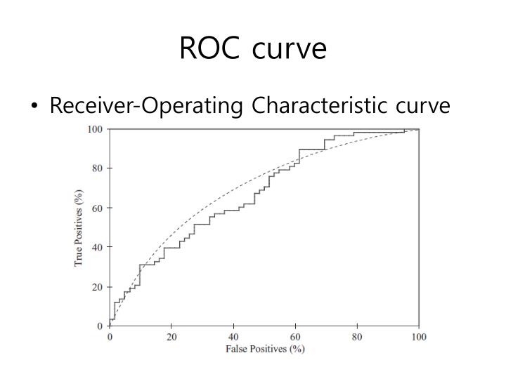
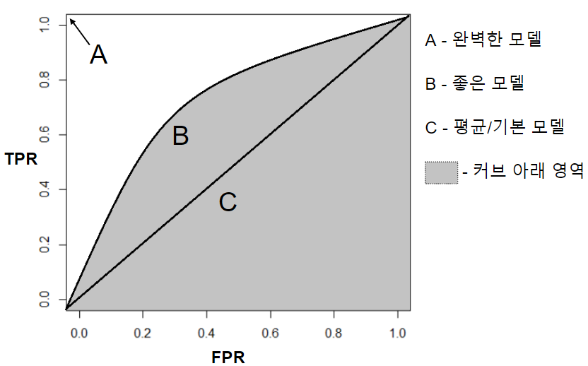
ROC Curve
Page. 7
분류모델의 성능평가에 활용(특히 진단 등 의료분야에서 널리 쓰임)
TPR(y축)과 FPR(x축)을 plotting
TPR = Recall
FPR = 1 – Specificity
Benefit(TP)과 Cost(FP)간의 Balancing에도 활용
True Positive Rate
False Positive Rate

Slide 9
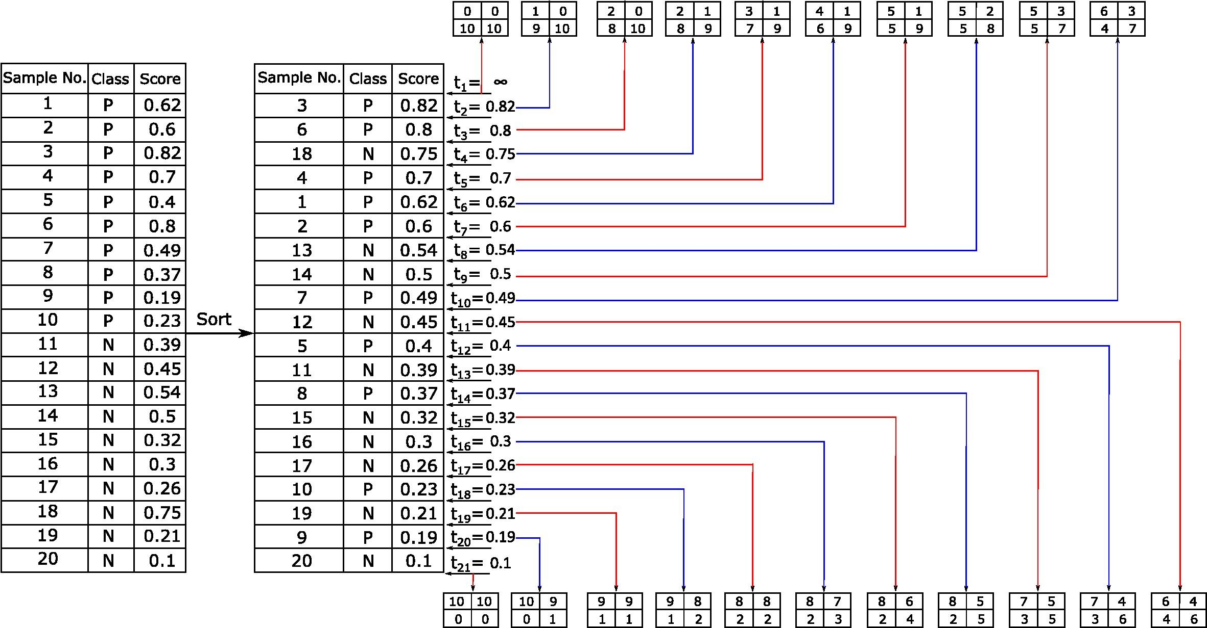
ROC Curve
Page. 8

Slide 10
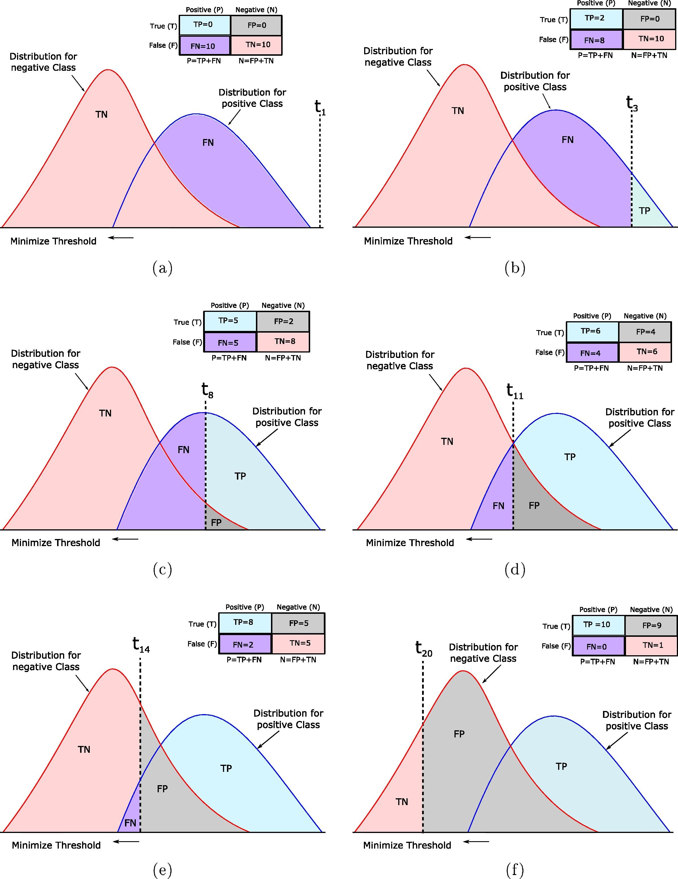
ROC Curve
Page. 9

Slide 11
ROC Curve
Page. 10

Slide 12
ROC Curve
Page. 11

Slide 13
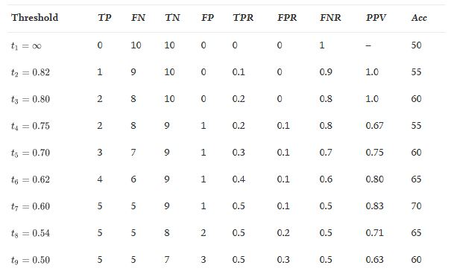
ROC Curve
Page. 12

Slide 14
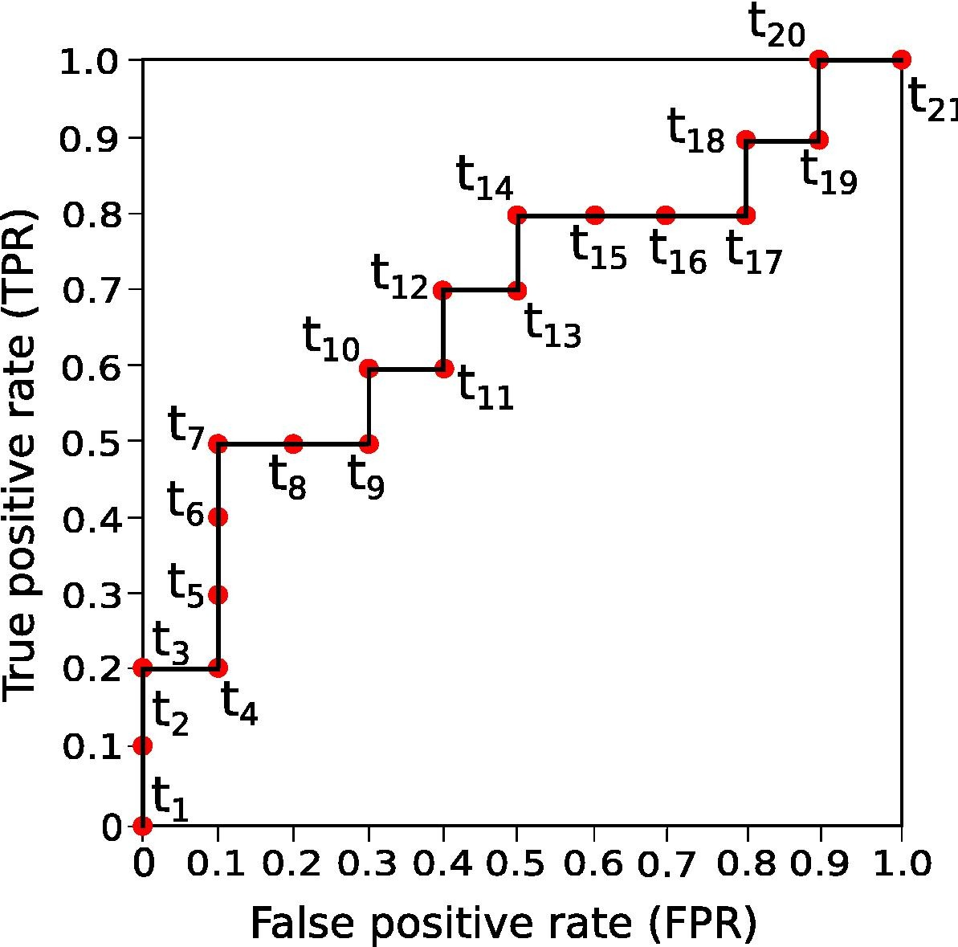
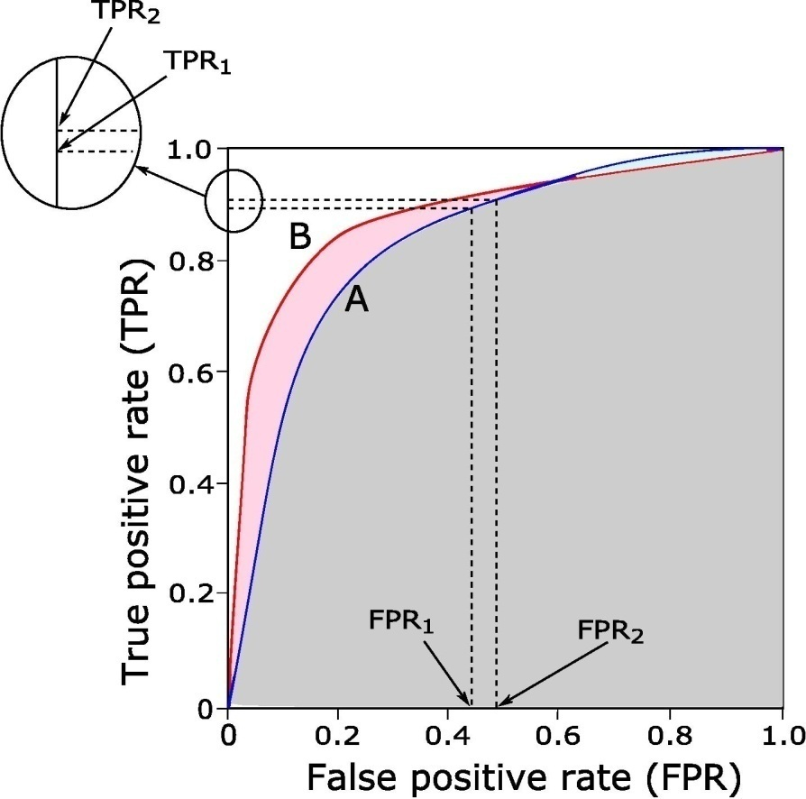
ROC Curve
Page. 13
샘플의 개수가 늘어날수록
계단형 그래프가 곡선으로 바뀌게 됨
분류모델간 성능비교 : AUC
AUC (Area Under the ROC Curve) : 0~1

Slide 15

감사합니다 !

